Slide 1

Free Lunch
with
NYC Analytics
Optimizing School Lunch Programs with Python
PyData NYC: Tuesday Nov 28, 2017

Slide 2
Outline
MODA overview
What’s a free lunch?
Combinatorial optimization - Monte Carlo methods
Improving runtime - vectorized methods in pandas and parallel processing
Results
Questions

Slide 3
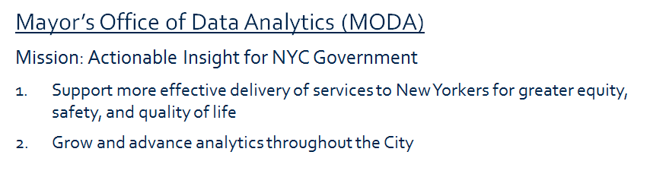

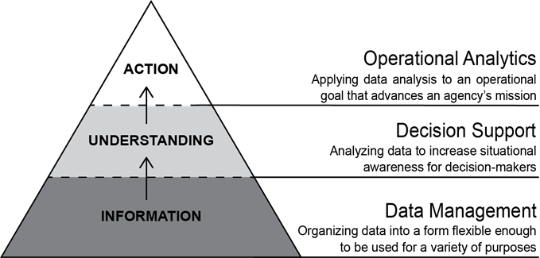
MODA and Open Source Analytics

Slide 4



Who pays for lunch?
Notes:
3 entities: Local school districts, Federal govt (dept of ag not ed!), and the students (or more accurately their families).
Traditionally the federal reimbursement depended on the student’s family income. This led to stigmatization and so there has been a push for Universal Lunch program.

Slide 5

Universal lunch programs
Move away from individual student based reimbursement (stigma)
All meals at a school are reimbursed the same way
All students receive meals at no cost
CEP program - Local school districts can apply for federal reimbursement
Based on set percentage of “identified students” of the school or group of schools
No constraint on how to group schools

Slide 6

NYC Department of Education
Over 1 million students
Over 1500 schools
Analytics question:
What’s the best way to group schools to maximize reimbursements in order to take full advantage of the federal CEP (universal lunch) program?

Slide 7
CEP - Reimbursement Rules
All lunches reimbursed at either the “free” or “paid” rate
Percent reimbursed at the “free” rate (higher rate) depends on group’s makeup.
Reimbursement rates at a school in group g
Depends on group:
threshold_{g} = %identified_{g} * 1.6
64% < threshold_{g}< 100%
free rate
paid rate
threshold_{g}
100%
lunches

Slide 8
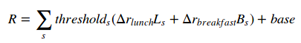
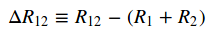
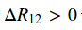
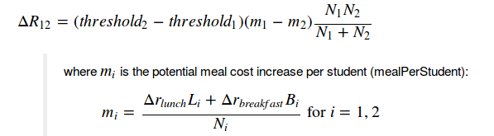
Combining schools
GOAL: Maximize
m
All meals reimbursed at the “paid” rate.
Difference between combining schools and keeping them separate:
threshold
m
threshold

Slide 9
Brute Force - Combinatorics
How many ways of grouping a set of n objects into k groups?
Stirling Partition Number: S(n,k)
S(3,2) = 3
S(30, 10) = 1.73 x 10²³
S(100,10) = 2.75 x 10⁹³
→ brute force fails for even just 30 schools
But NYC has over 1500 schools, clearly we need another way...
Notes:
brute force fails even for just 30 schools (years even with supercomputers)

Slide 10
Monte Carlo
Initialize: Randomly group all schools
Take a ‘step’: Choose a random school and change its group
Compare: Calculate the difference in reimbursements (ΔR)
Accept/Reject: If ΔR>0, accept move If ΔR<0, reject move.
Repeat
Method also called - Stochastic Hill Climbing

Slide 11
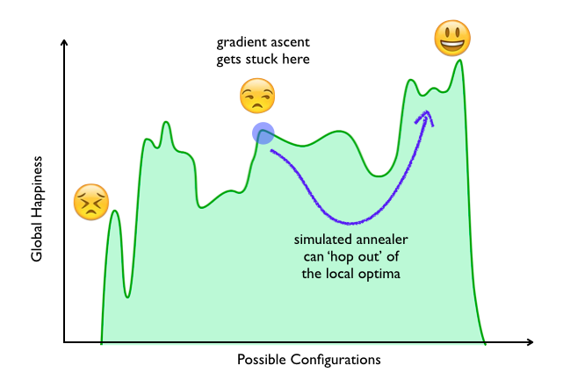
What about local maxima?

Slide 12
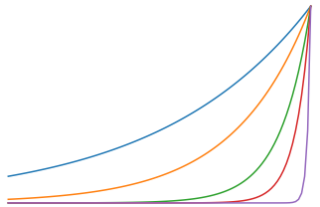
Simulated Annealing
Initialize: Randomly group all schools
Take a ‘step’: Choose a random school and change its group
Compare: Calculate the difference in reimbursements (ΔR)
Accept/Reject: If ΔR>0, accept new state If ΔR<0, then accept with probability e^{ΔR/T}
Repeat, letting T→ 0
e^{ΔR/T}
T → 0
^{ΔR}

Slide 13
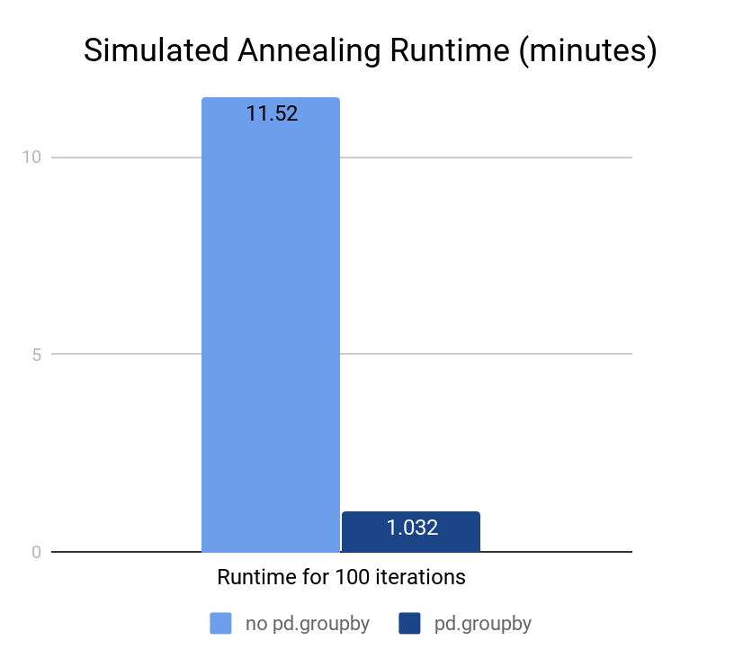
Optimizing for faster runtime
Vectorize!
Avoid any and all loops
group once, aggregate stuff many times
pd.groupby is incredibly versatile
Parallel Processing!
Run many trials at once

Slide 14
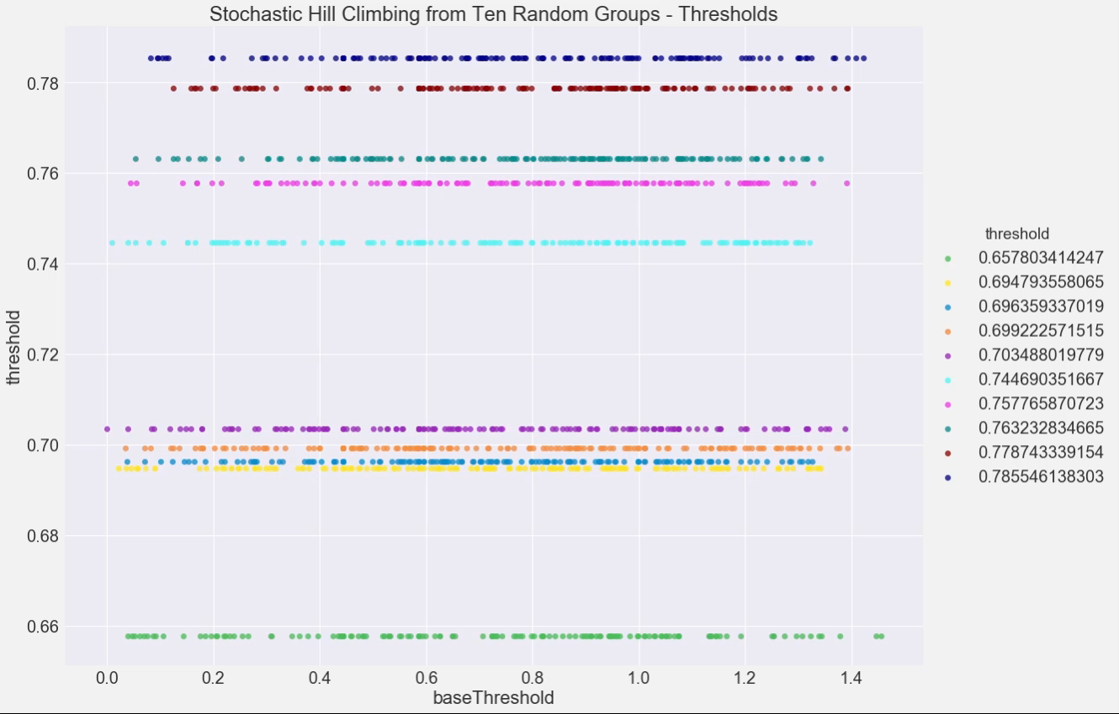
Video of Simulation

Slide 15
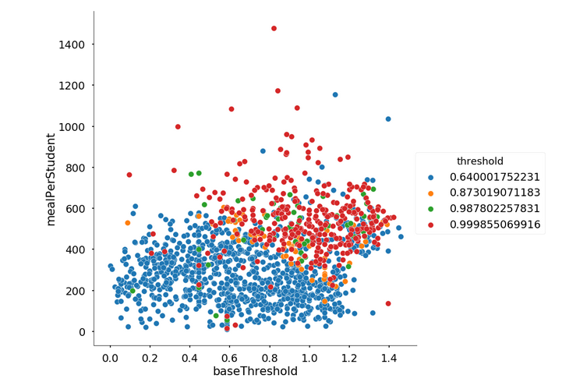
Results
Monte Carlo - simulated annealing method
Best of 100 runs
Dollar amount saved using MC: $11 million (or about 5%)

Slide 16
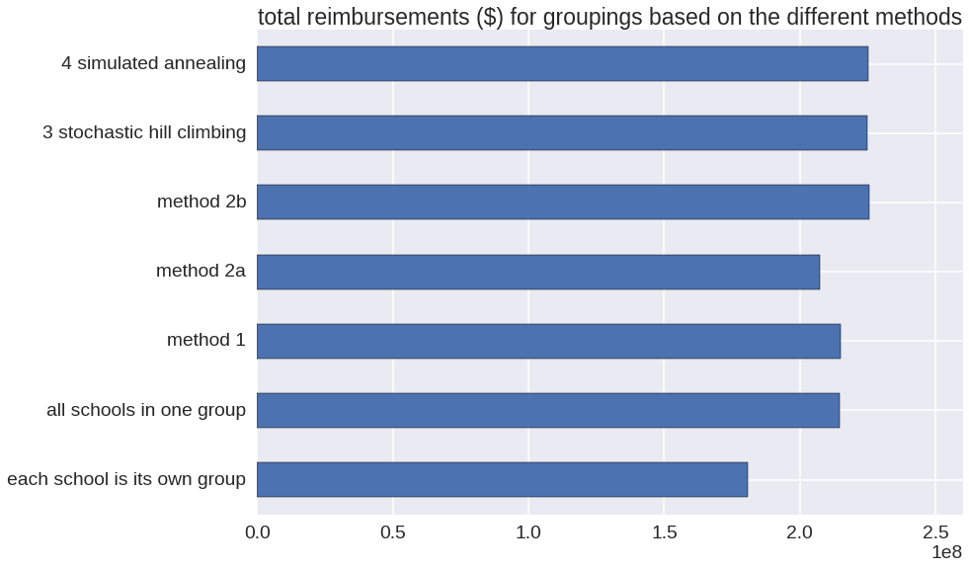
Results - compared to other methods

Slide 17


Questions?
Online:
www.nyc.gov/analytics https://moda-nyc.github.io/Project-Library/
Contact us:
Deena Patel - dmpatel@analytics.nyc.gov
Simon Rimmele - srimmele@analytics.nyc.gov

